Slide 1
Serious simplifications of HIV testing,
ART, and PrEP to enhance the cascade
Praphan Phanuphak, MD, PhD
The Thai Red Cross AIDS Research Centre
Cross-track bridging sessions: The “double-sided” cascade of HIV prevention and care
AIDS 2018, Amsterdam: July 26, 2018

Slide 2
Disclosure
PP has received research funds from
Gilead, ViiV, Tibotec, and Mylan
for his research organization, HIV-NAT.

Slide 3
HIV testing is the centerpiece for prevention and treatment cascade
Enhanced HIV Testing through KP Lay Providers
Simplified Same-Day PrEP
Same-Day ART
Source: LINKAGES HIV Cascade Framework for Key Populations, 2015.

Slide 4
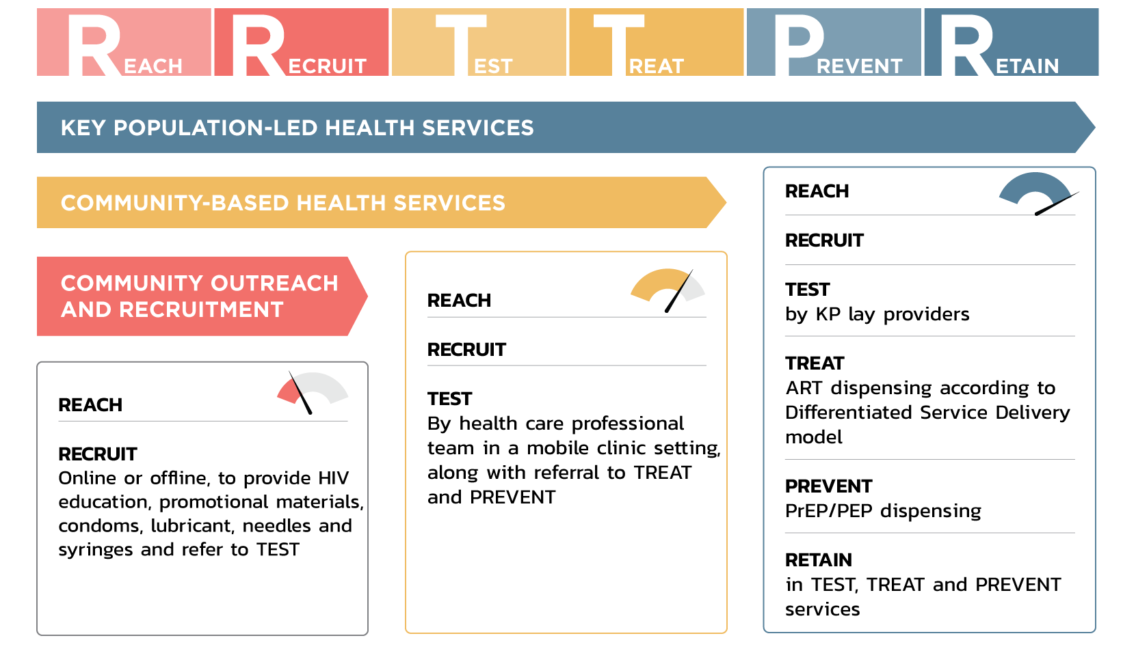
Engaging Key Populations in each step of
Reach-Recruit-Test-Treat-Prevent-Retain cascade

Slide 5
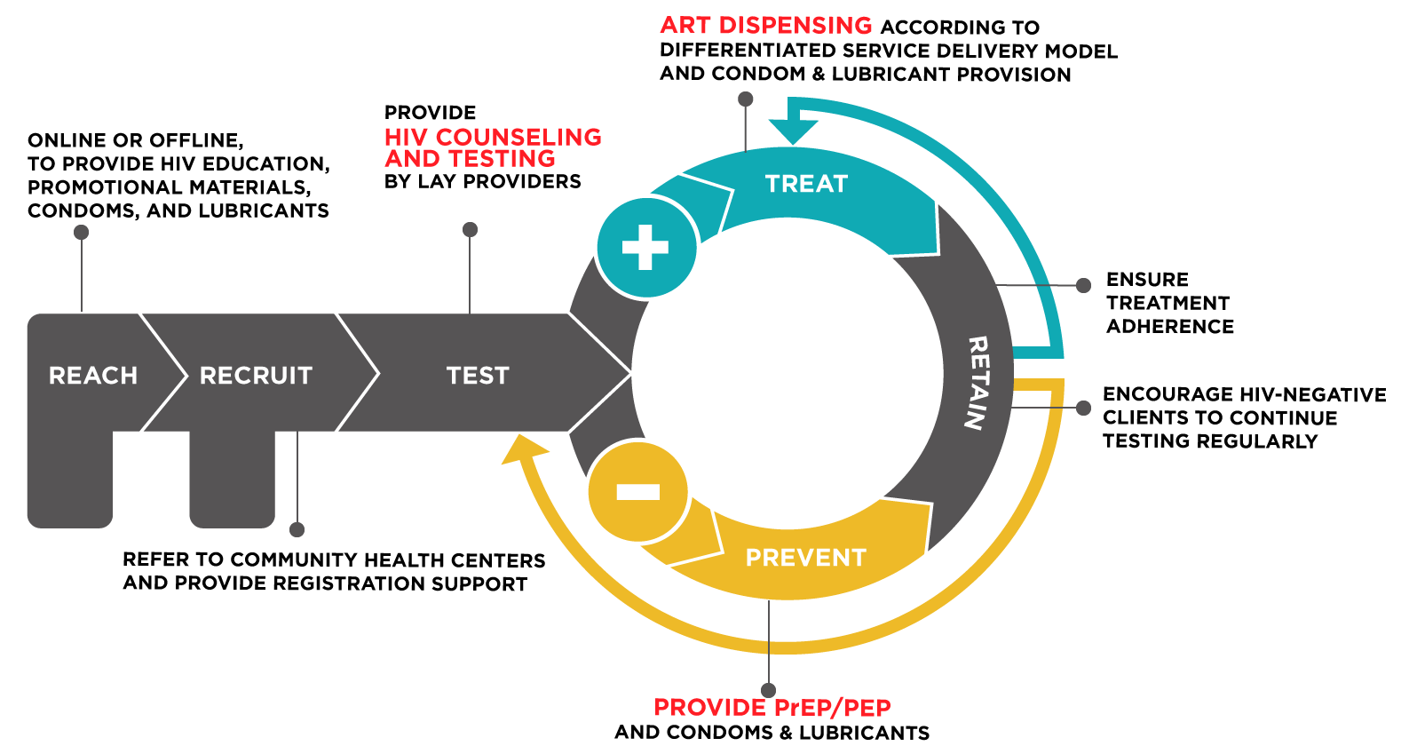
Key Population-Led Health Services (KPLHS)
Source: TRCARC Key Population-Led Health Services model.

Slide 6
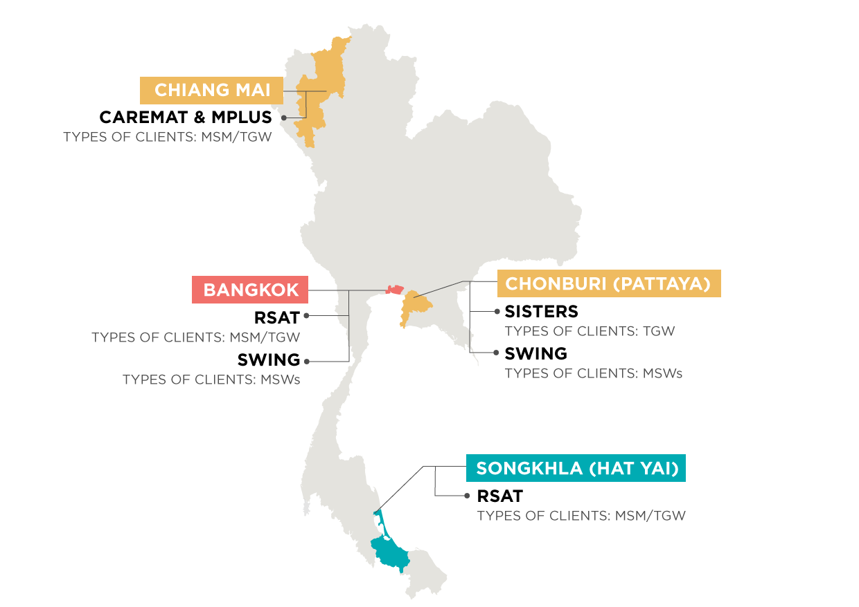




KP-Led Test & Treat and PrEP services in Thailand
Local hospitals and public health offices provide QA/QI and mentoring

Slide 7
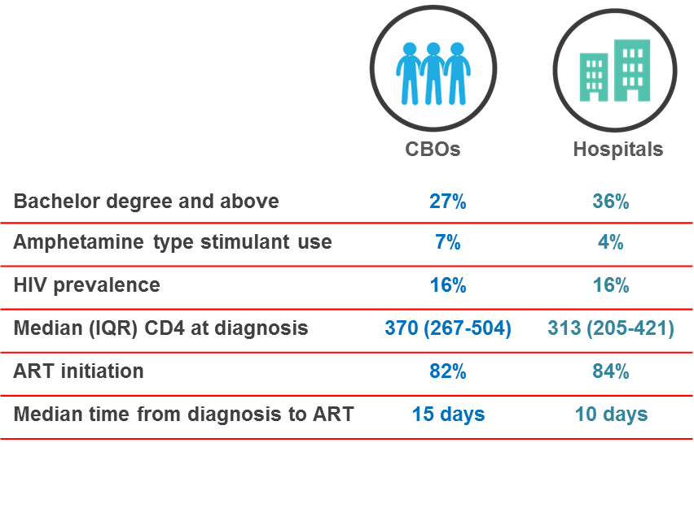
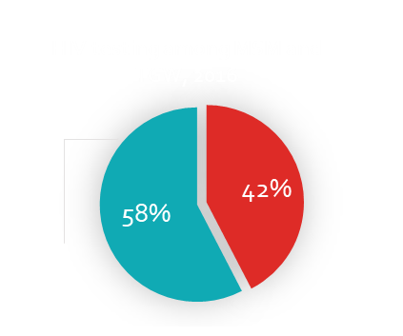
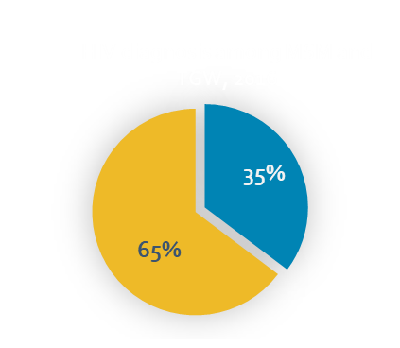
KPLHS significantly contributes to national HIV testing figures among MSM and TGW
More than 15,000 HIV testing and 2,000 PrEP services were provided to MSM and TGW in Thailand by KP lay providers in 2016-2017
CBOs
HOSPITALS
CBOs
HOSPITALS

Slide 8
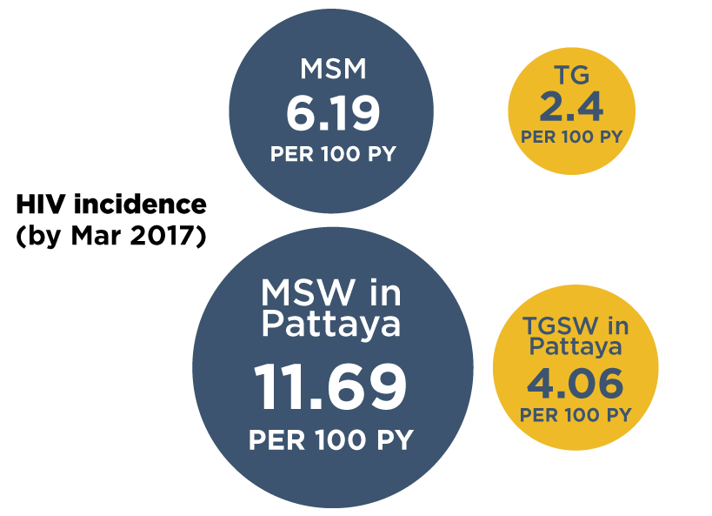
Thai MSM and TGW at high risk identified through KPLHS
HIV prevalence of 9% among TGW
and 18% among MSM
>80% successful linkage to ART
Successfully engage
at-risk individuals with
high incidence of HIV
PrEP TARGETS
Source: TRC Community-Led Test and Treat Study among Thai MSM and TG (Mar 2017).

Slide 9
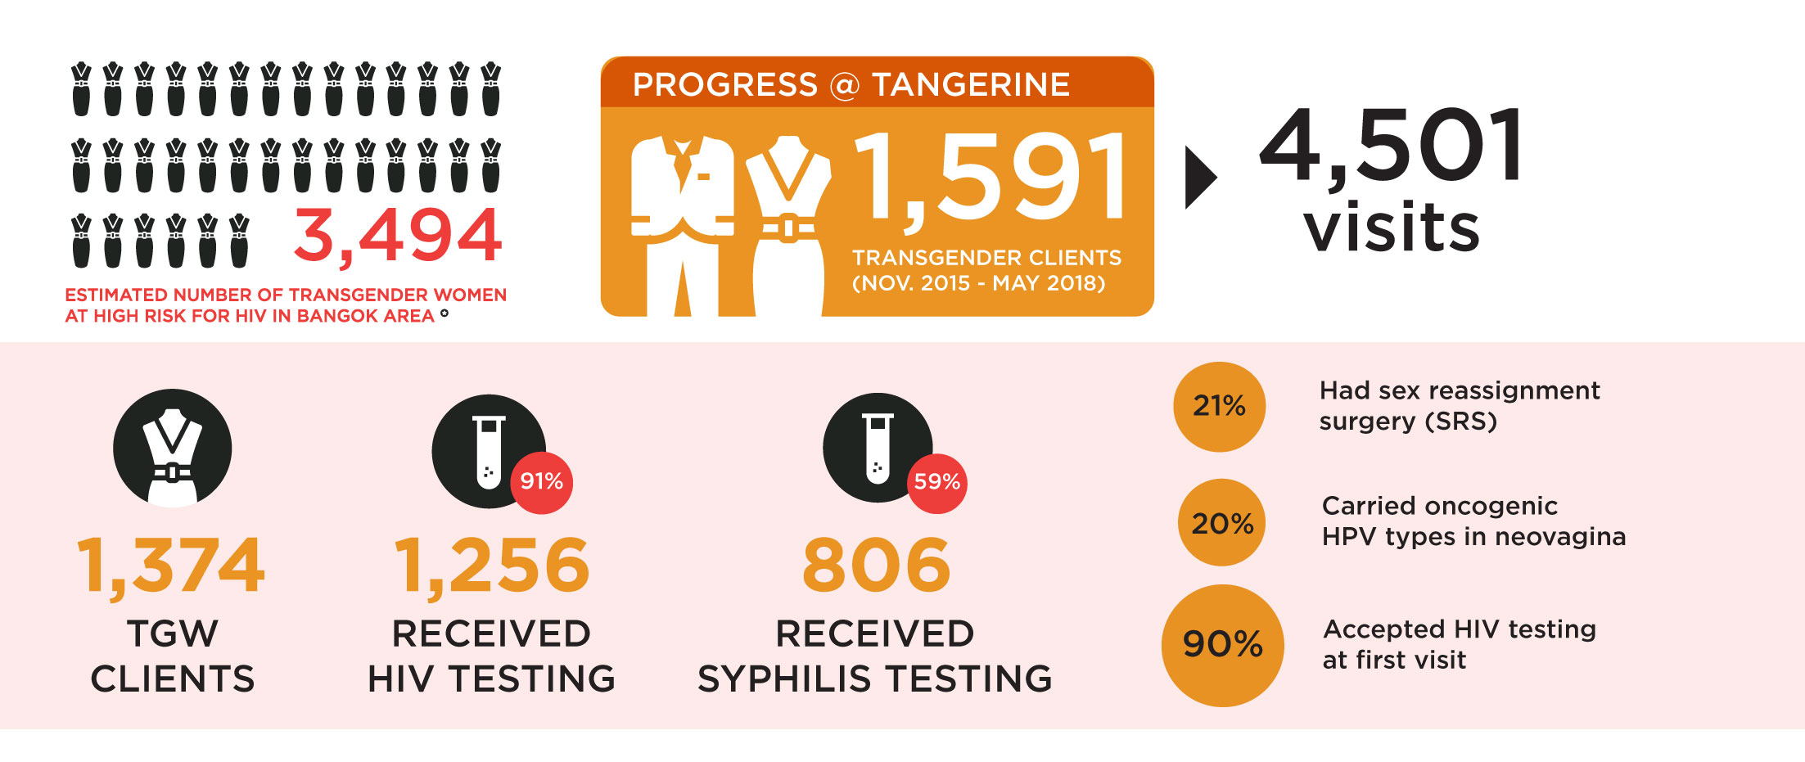
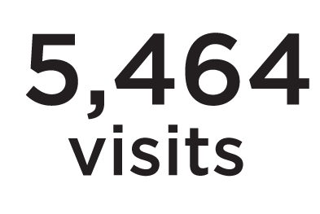
Tangerine Clinic transgender clients

Slide 10
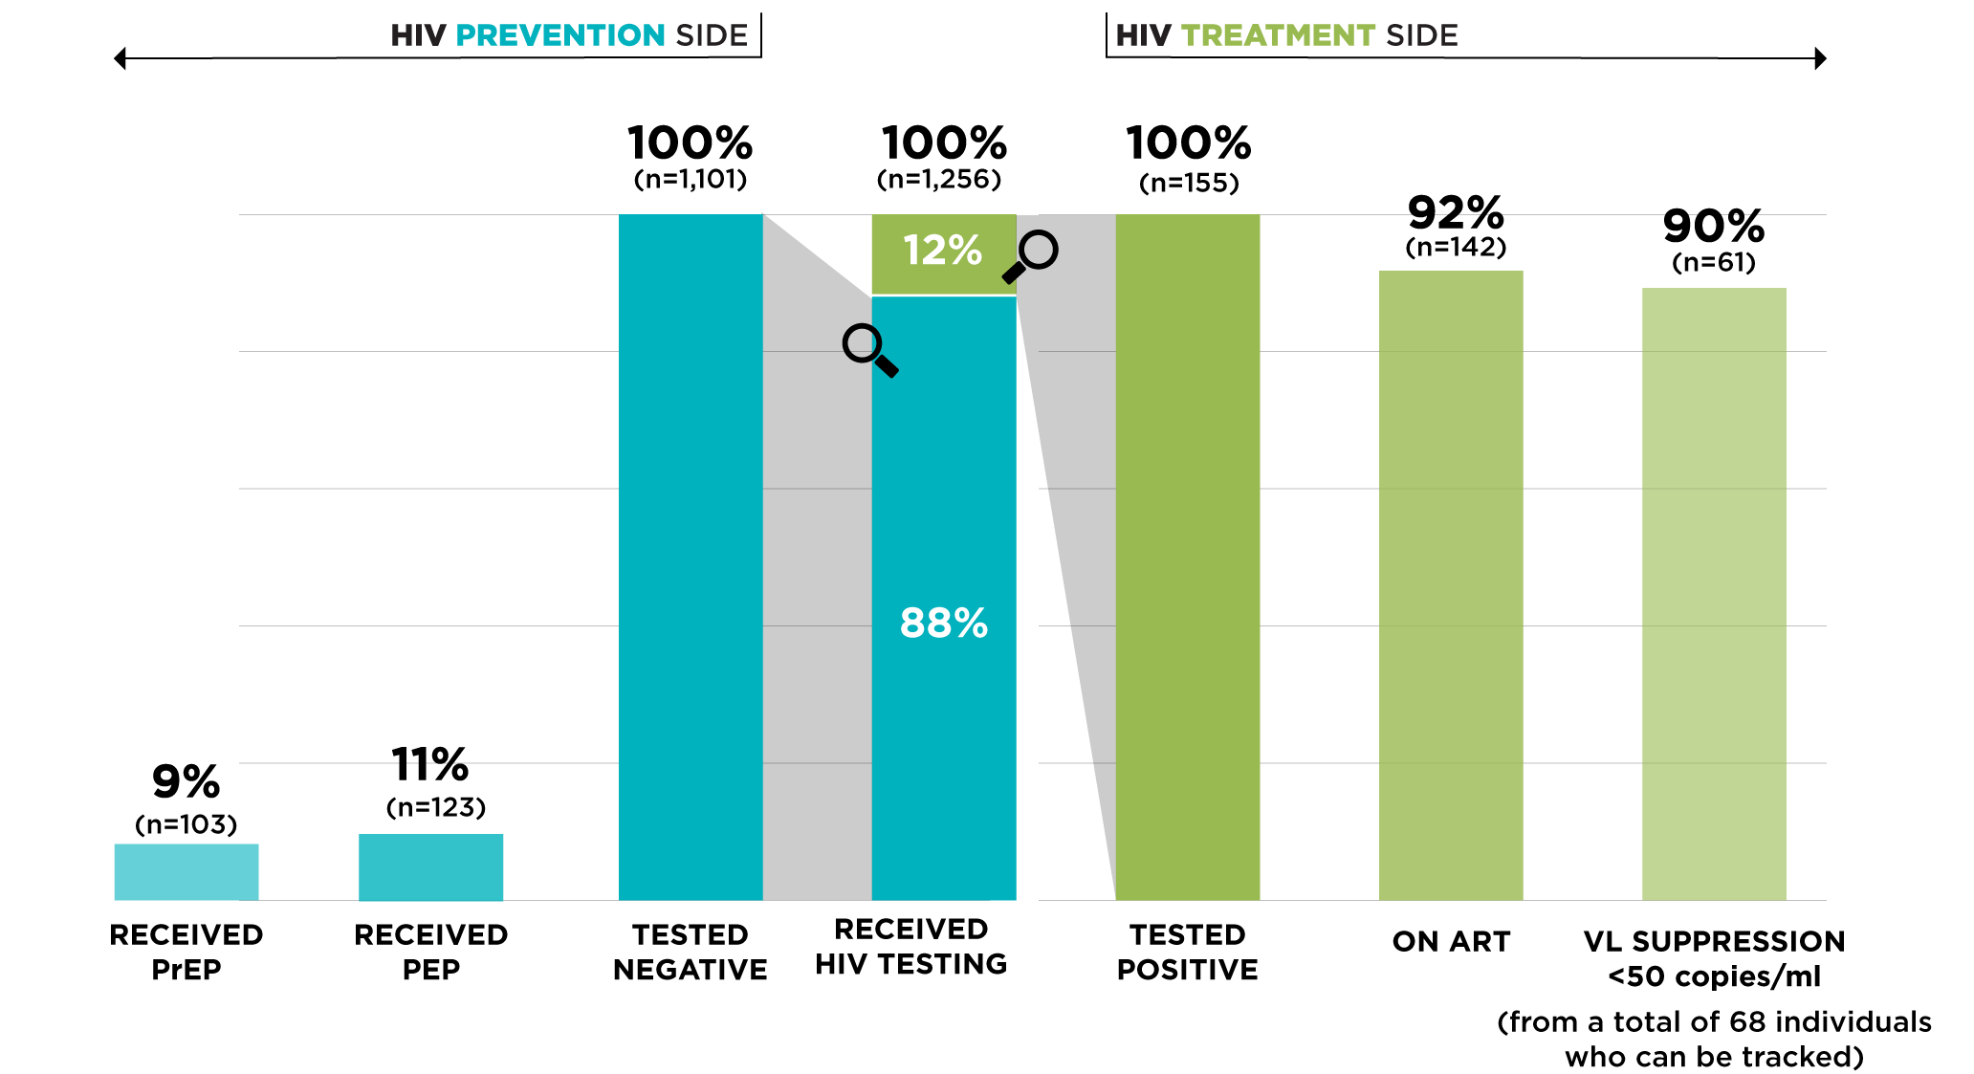
The Double-sided HIV Cascade Performance

Slide 11
Reasons for delayed ART initiation after (even early) diagnosis in Thailand
Patient factors: poor perception of self-care, treatment literacy, stigma & discrimination
Physician factors: unaware about the new guideline, ignores because of personal belief / judgement of patient’s readiness, needs repeated session of adherence counseling
Hospital factors: eligible hospital is in another province, crowded, long appointment, may run across some acquaintances
Health system factors: inadequate HCW and lab facility (CD4, Cr, crypto Ag, etc.), no clear-cut policy on task shifting, DSD, etc.

Slide 12
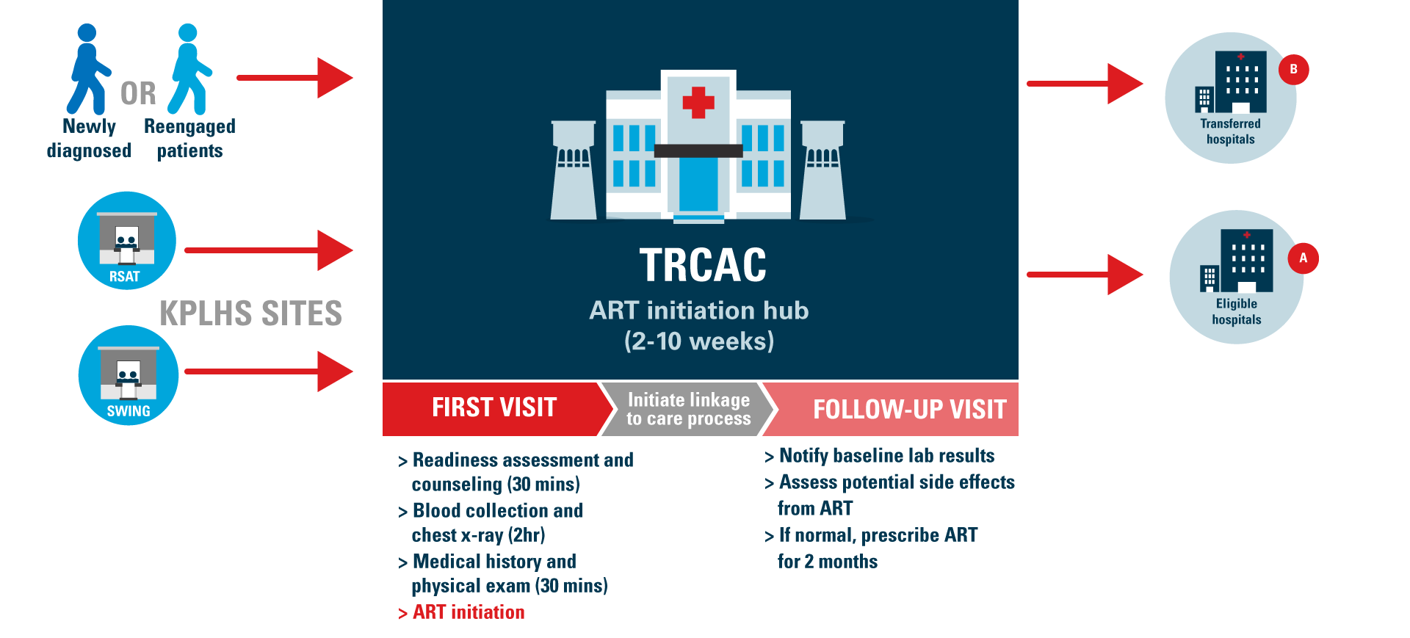
Same-Day ART using ART Initiation Hub Model at the TRC Anonymous Clinic
CD4, HBsAg, Cr, syphilis serology, crypto Ag
(if CD4<100)
Navigator is essential

Slide 13
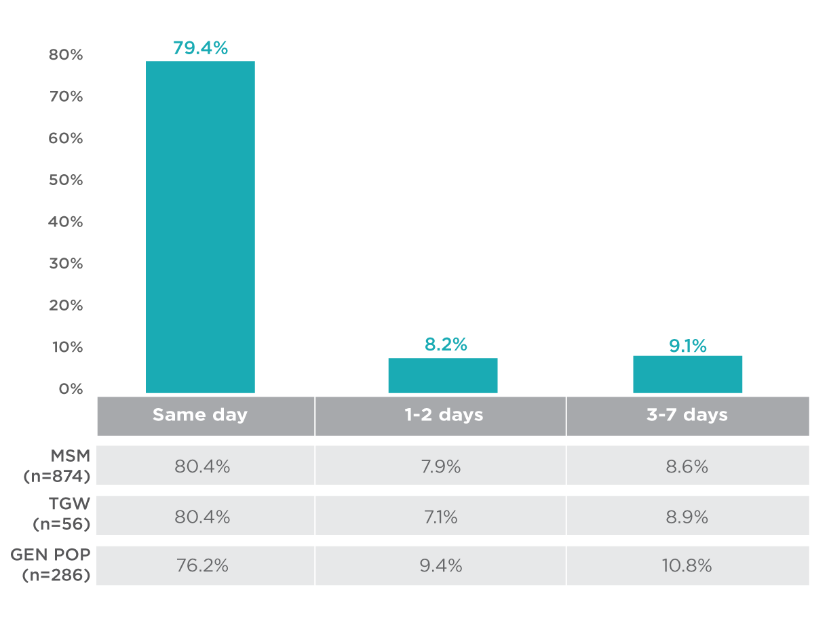
Same-Day ART: ART initiation time
(TRC Anonymous Clinic, Jul 2017 – Jan 2018, Unpublished)
Source: Same-Day ART database, Thai Red Cross Anonymous Clinic (July 2017-Apirl 2018).

Slide 14
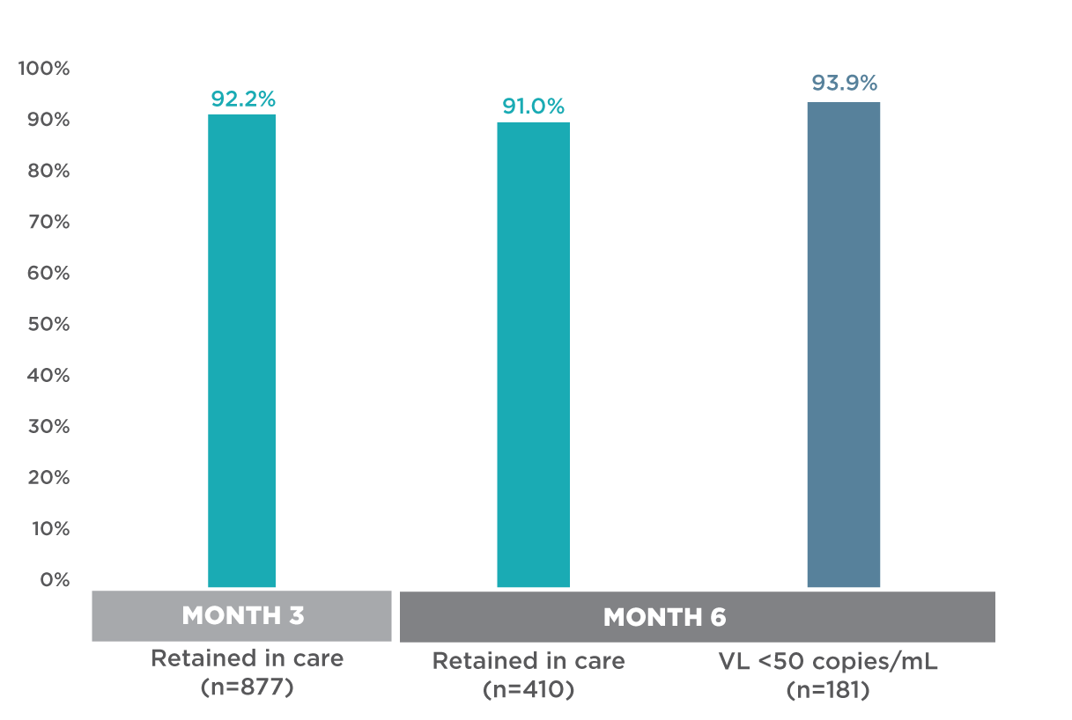
Same-Day ART: Retention and VL suppression
(TRC Anonymous Clinic, Jul 2017 – Jan 2018, Unpublished)
Source: Same-Day ART database, Thai Red Cross Anonymous Clinic (July 2017-Apirl 2018).

Slide 15
Thailand’s PrEP Programs
iPrEX showed 44% prevention efficacy among MSM with daily TDF/FTC
Free PrEP for high-risk MSM and TGW
The 1st Test & Treat project in MSM and TGW in 4 provinces
PrEP-30 at
TRCARC
PrEP@Piman
Princess PrEP
PrEP2Start
NOV.
2010
DEC.
2012
DEC.
2014
JAN.
2016
JAN.
2017
OCT.
2018
JUL.
2011
OCT.
2014
MAY
2015
MAR
2016
HPTN 052, 96% prevention efficacy with immediate ART
National guidelines recommended ART regardless of CD4 count and PrEP
Community-Led and Facility-Based Test & Treat projects, along with PrEP substudy in MSM and TGW
PrEP at SCC@ TropMed

Slide 16
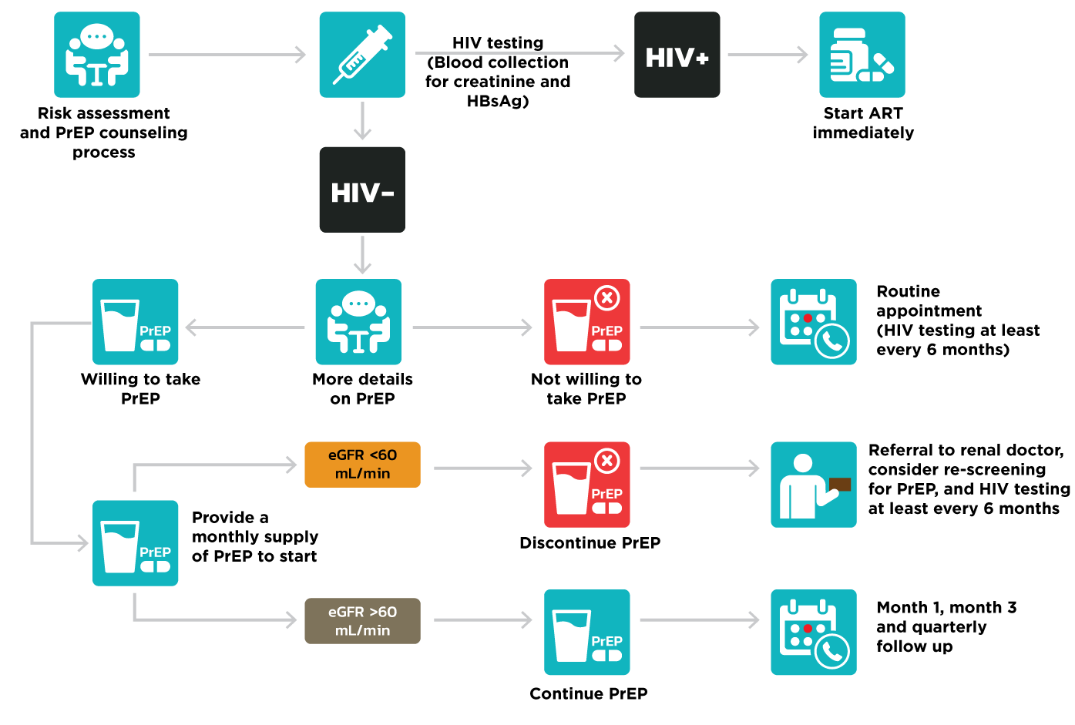
Same-day PrEP flow in Princess PrEP
Source: TRCARC Princess PrEP Same-Day PrEP flow.

Slide 17
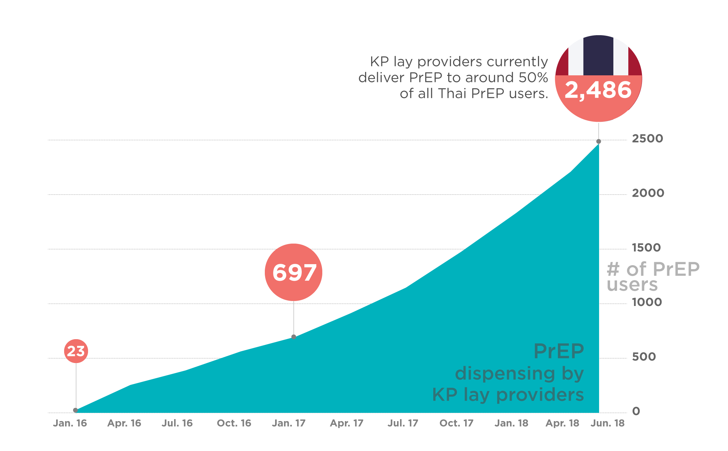
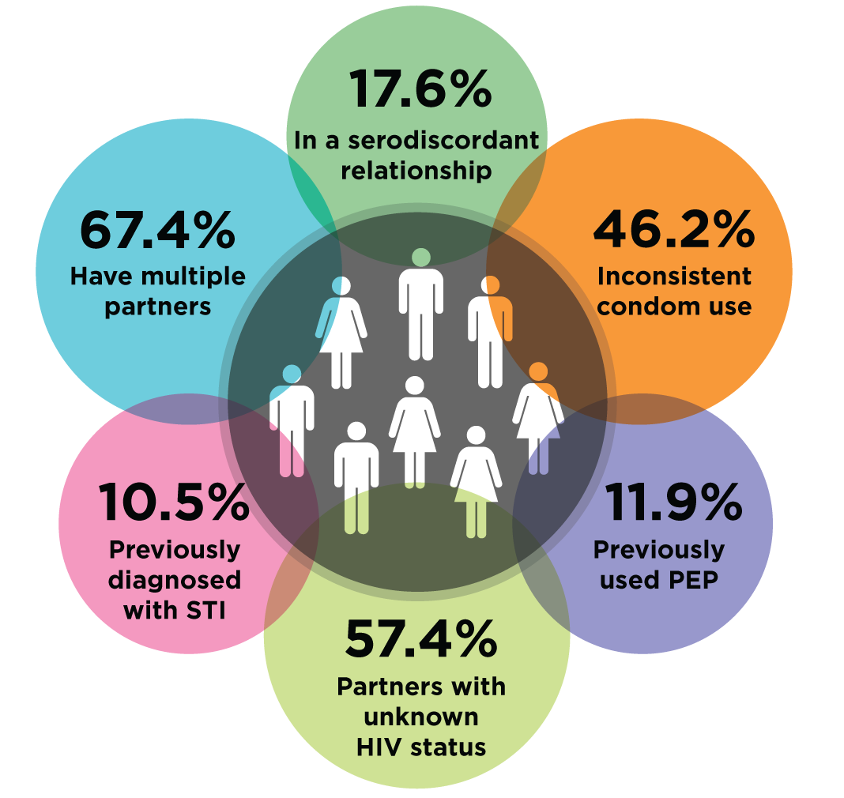
Thailand Princess PrEP Program: KP-led PrEP delivered by trained KP lay providers
Source: Princess PrEP, Thai Red Cross AIDS Research Centre/LINKAGES Thailand Project (Jan 2016-Jun 2018).

Slide 18
Thailand’s PrEP Programs
MUCH TOO SLOW → NO HERD EFFECT TO AVERT HIV INFECTIONS
KP-Led Private
Pulse Clinic*
KP-Led
Princess PrEP
AROUND 50% OF THAI PrEP USERS ACCESSED PrEP THROUGH KP LAY PROVIDERS
Fee-based PrEP-30
Source: Estimated number of PrEP users in Thailand by June 2018 (courtesy of each program leader)

Slide 19

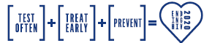
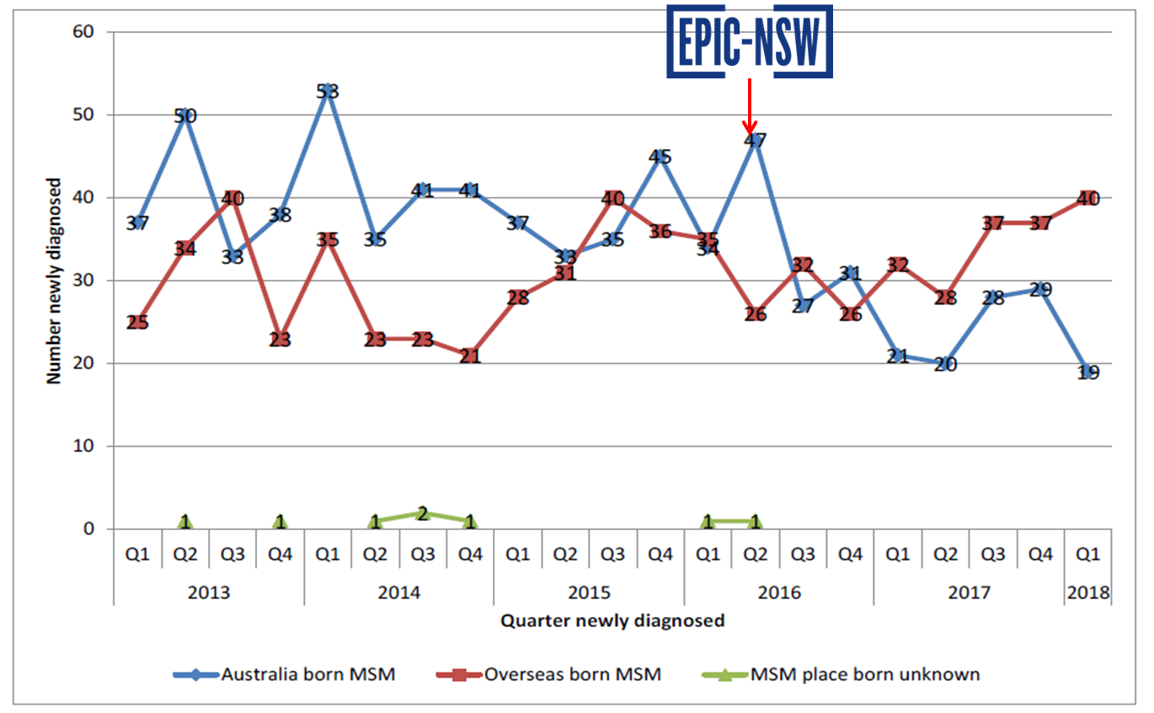
EPIC-NSW: Rapid, targeted, large-scale PrEP roll-out achieving rapid decline in new HIV diagnoses
Rapid roll-out of PrEP to 20% of sexually active gay/bisexual men in NSW within just a year
Source: Courtesy slides from Andrew Grulich and Karen Price’s ACON slide set.

Slide 20





Challenges in ending AIDS: Dysfunctional collaborations
  Too much ego among medical professionals which hampers task shifting
  Conservative requests for RCTs and cost-effectiveness studies
  Limited/lack of social science expertise and data
  PLHIV communities have been very strong for ART advocates
  Negative reactions commonly faced when PrEP or other modalities beyond condom use are introduced
  KP communities are getting more mature and capable of performing roles beyond conventional community’s roles, including being PrEP advocates
  HIV is a low-priority political issue (no champion figure)
  Rare sincerity or continuity
  Shy messages around needle and syringes program and PrEP (‘grey areas’), as well as task shifting (playing safe)

Slide 21
Conclusions
KPLHS model is feasible and effective in enhancing uptake of early HIV testing and treatment, as well as PrEP, among at-risk communities.
Enabling legal/regulation and financing environment is needed for KPLHS sustainability. This requires open-mindedness of healthcare professionals and policy makers.
Same-day ART is feasible although labor-intensive but worthy.
PrEP is an essential component in ending AIDS. It needs to be scaled up rapidly and widely to see an impact.
All of these simplification approaches, if implemented seriously, will fill the gaps of the prevention and treatment cascades, leading to ending AIDS.
We need serious and genuine interest and support from all stake holders, particularly from policy makers and politicians with a sense of urgency (fast-track), not business as usual. The earlier we can end AIDS, the better we are.

Slide 22
















Slide 23
THANK YOU VERY MUCH

